Slide 1

CCSS CREAMS
KOK Siu Chung 20190875A***
HO Chun Hei 20096776A
MOK Ho Ming 20072190A
TO Fui Yin 20199034A

Slide 2
Table of Contents
Introduction
Business rule
Conceptual Models(ERD)
Logical Design
Demonstration
Conclusion

Slide 3

Introduction
CC secondary school
Provide extracurricular activities for students
Inform students what they can participate in
Register activities
Store activities and club data

Slide 4
Business rule
Students
Sign up for activity.
Store the academic results
Chairman
Add activities
Take attendance
Teacher
Everything Chairman could do
Manage Club and Activity

Slide 5
Students
Table | Table | Relationship
student_information | student_login | 1:1
 | student_selfAccount | 1:1
 | student_grade | 1:M
 | student_academic | 1:M
 | student_medical | 1:M
 | student_guardian | 1:M
 | student_awards | 1:M
 | club_schoolYear | 1:M
 | club_record | 1:M
 | activity_records | 1:M

Slide 6
Clubs
Table | Table | Relationship
club_information | club_schoolYear | 1:M
club_schoolYear | club_record | 1:M
club_record | activity_information | 1:M
activity_information | activity_records | 1:M
teacher_information | club_schoolYear | 1:M
 | activity_information | 1:M
 | teacher_login | 1:1

Slide 7
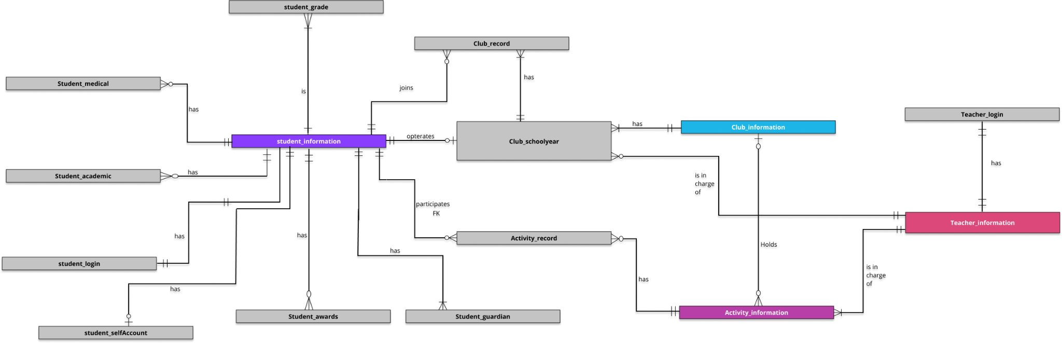
Conceptual model (ERD)

Slide 8
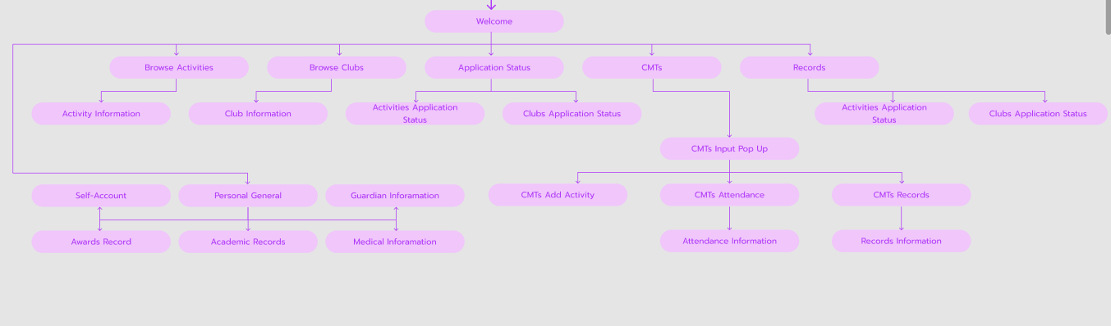

Slide 9
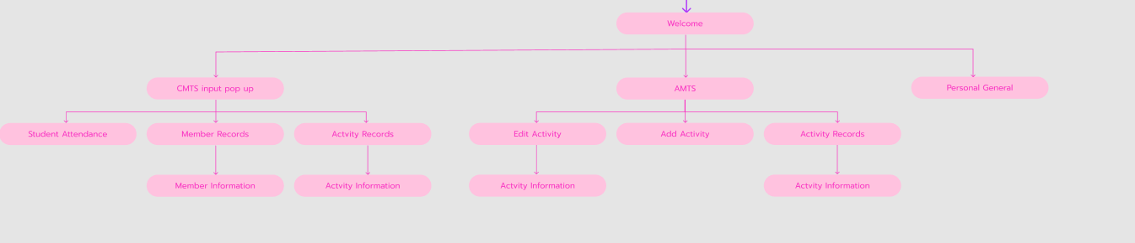

Slide 10
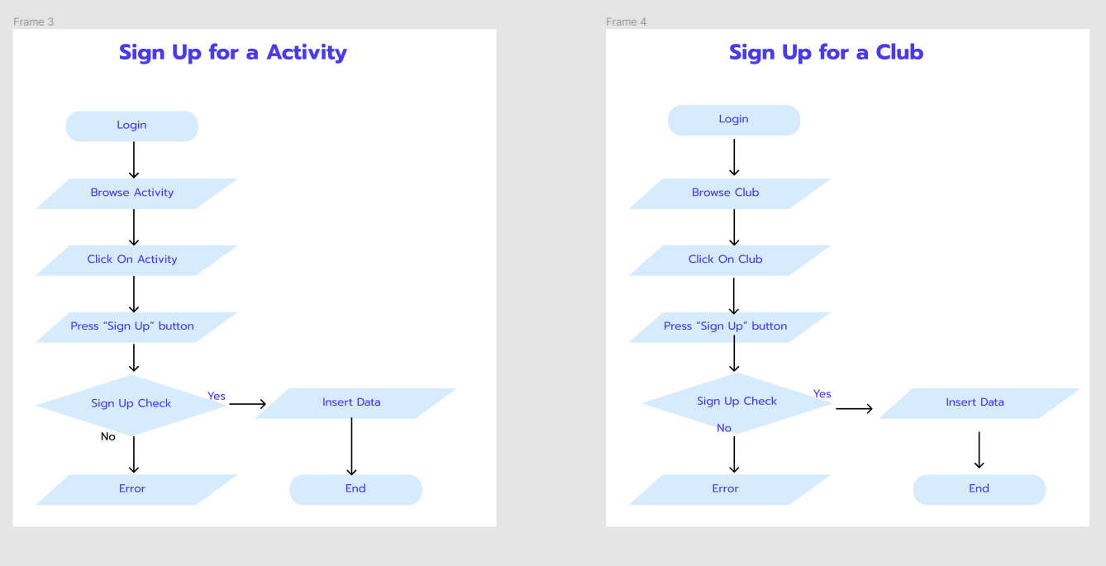

Slide 11
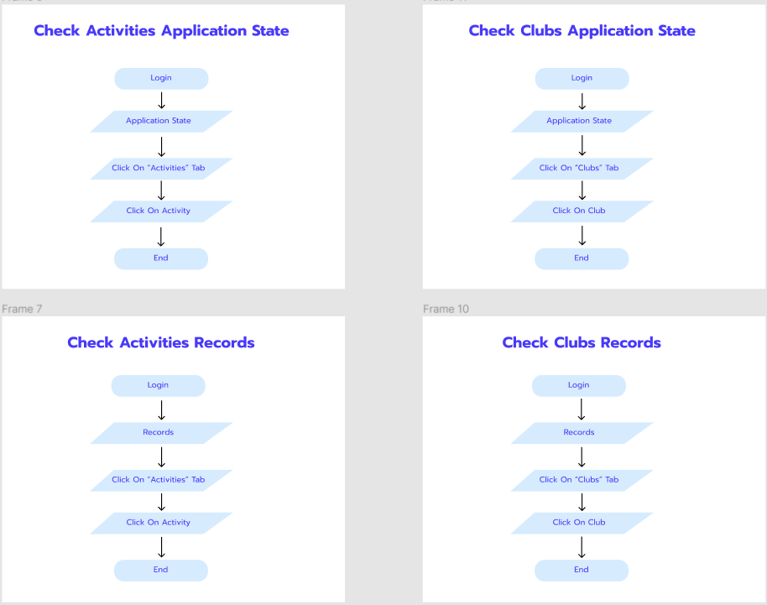

Slide 12
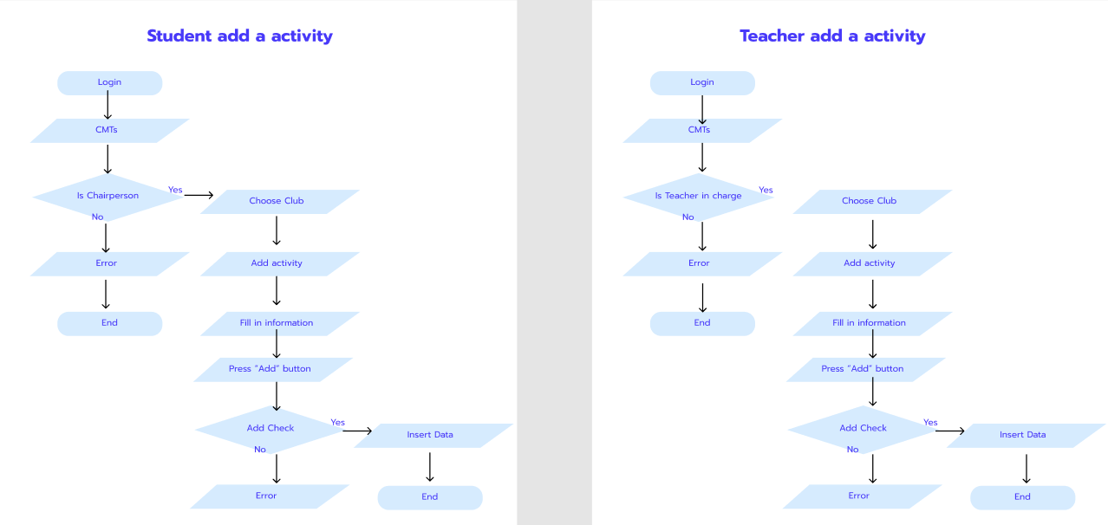

Slide 13
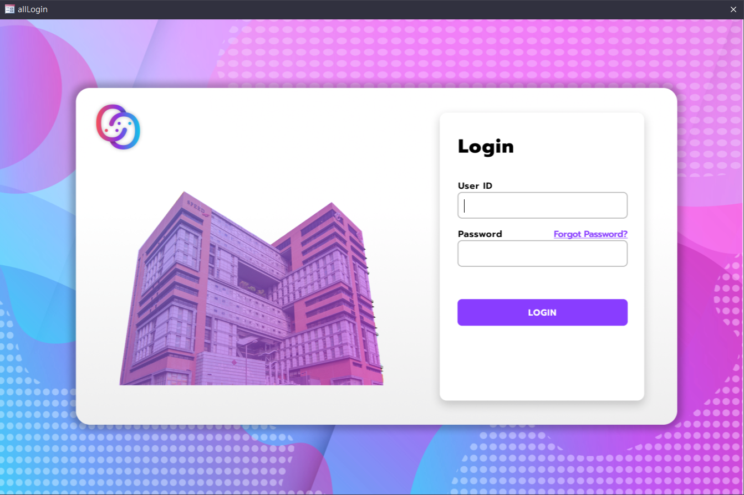
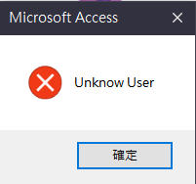
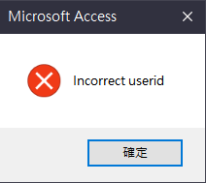
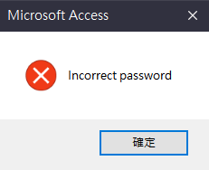
Logical design
Login page
Platform for students and teachers to login
Error login box
Only show when user enter inappropriate
userId and password

Slide 14
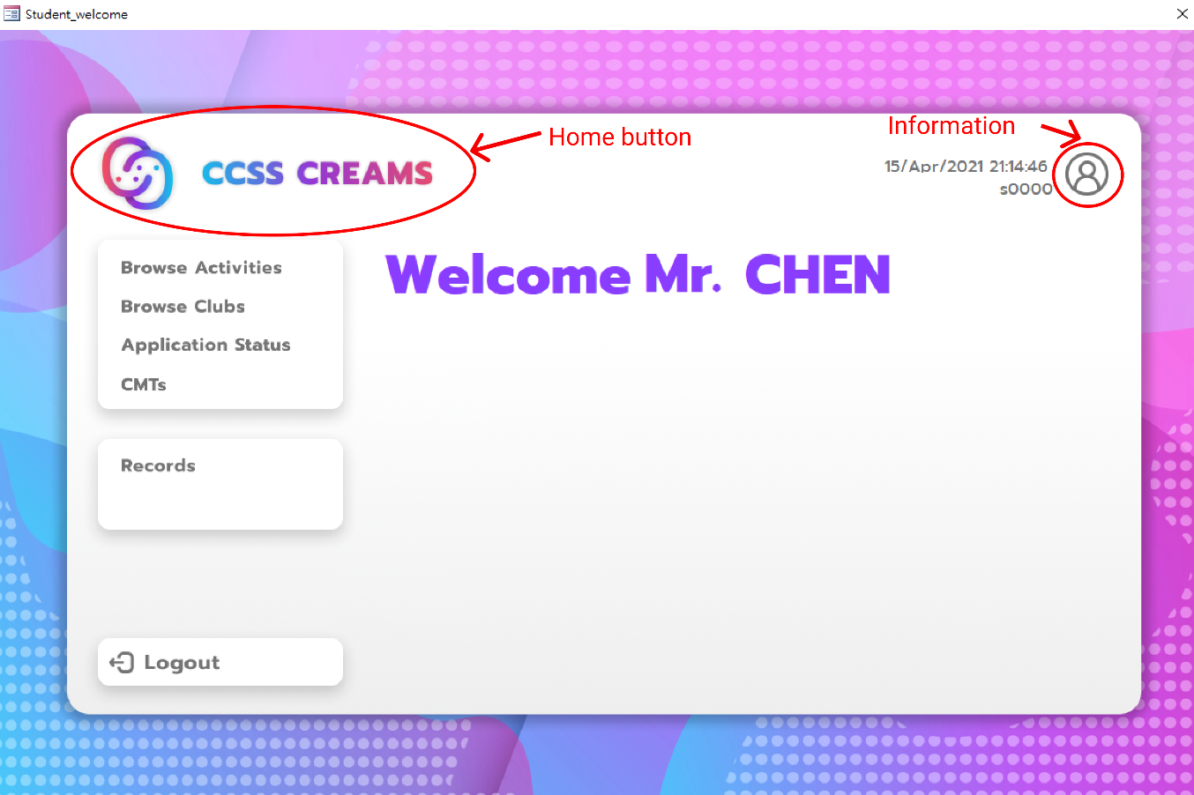
Navigation button
Browse Activities
Show activities
Browse Clubs
Show clubs
Application Status
Show application status
CMTs
For chairman use
Records
Show participation records
CCSS logo
Home button
Personal information logo
Show personal information
logout

Slide 15
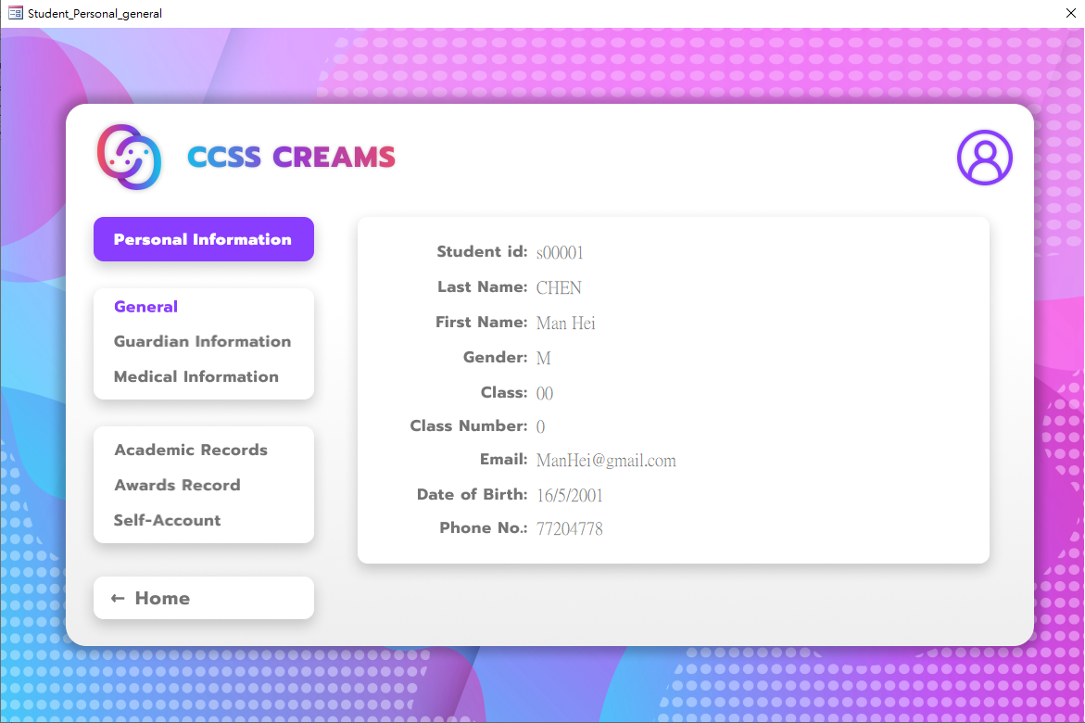
Navigation button
General
Show personal information
Guardian Information
Show guardian information
Medical Information
Show medical information (allergies)
Academic Records
Show academic records with school year
Awards Record
Show awards record with school year
Self-Account
Show student’s self introduction
Home

Slide 16
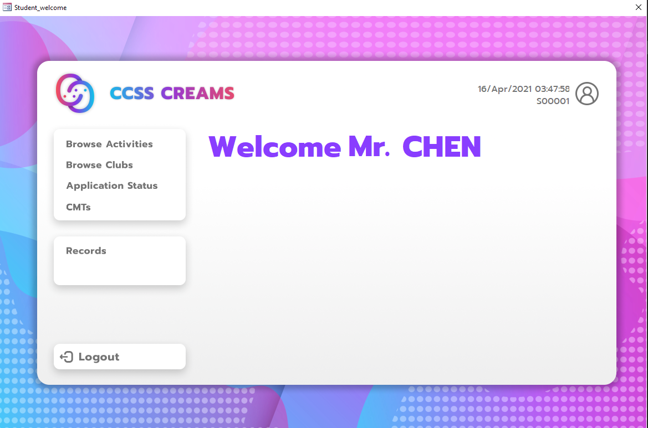
Student
Browse Activities
Browse activities to sign up
Browse Clubs
Browse clubs to sign up
Application Status
Check Act. and Club application
CMTs
Club Management Tools
Records
Check Act. and Club Records
Logout

Slide 17
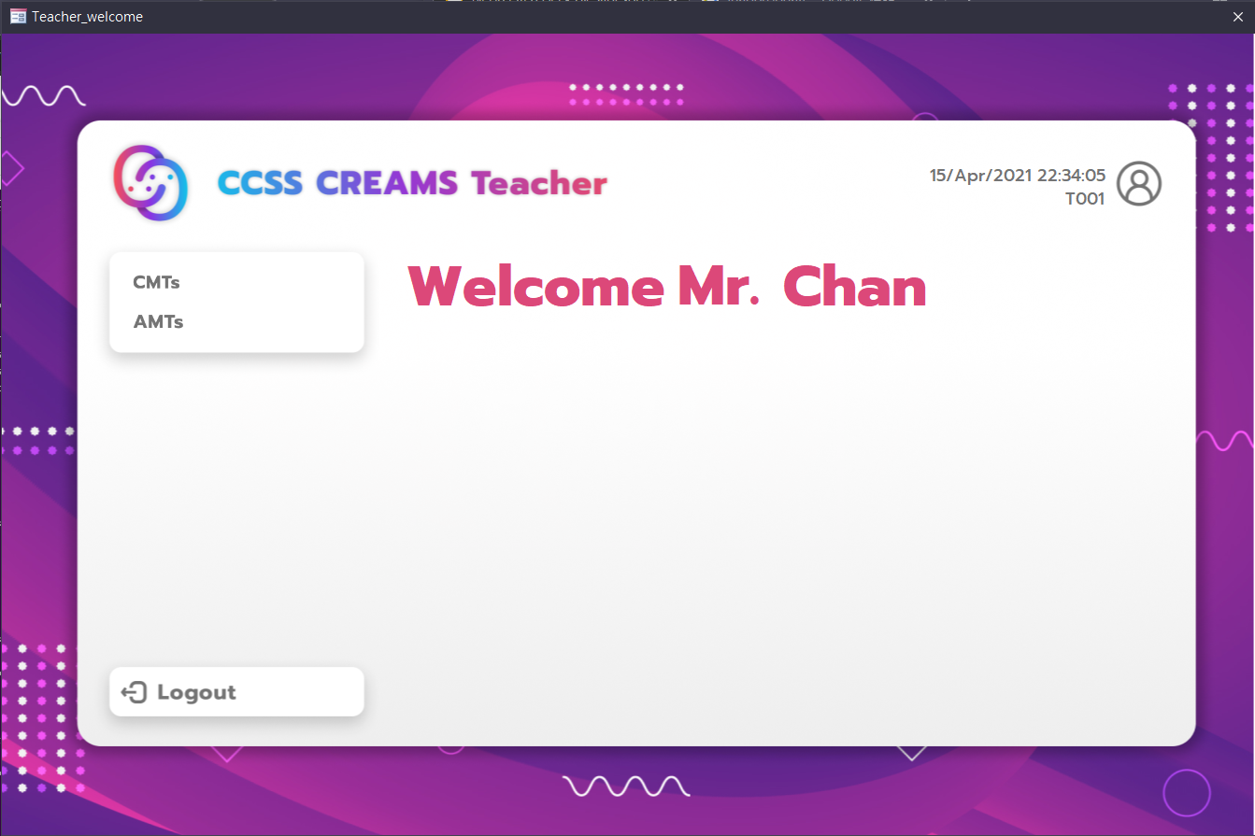
Teacher
CMTs
Club management
AMTs
Activities management
Personal information
Show personal information
Logout

Slide 18
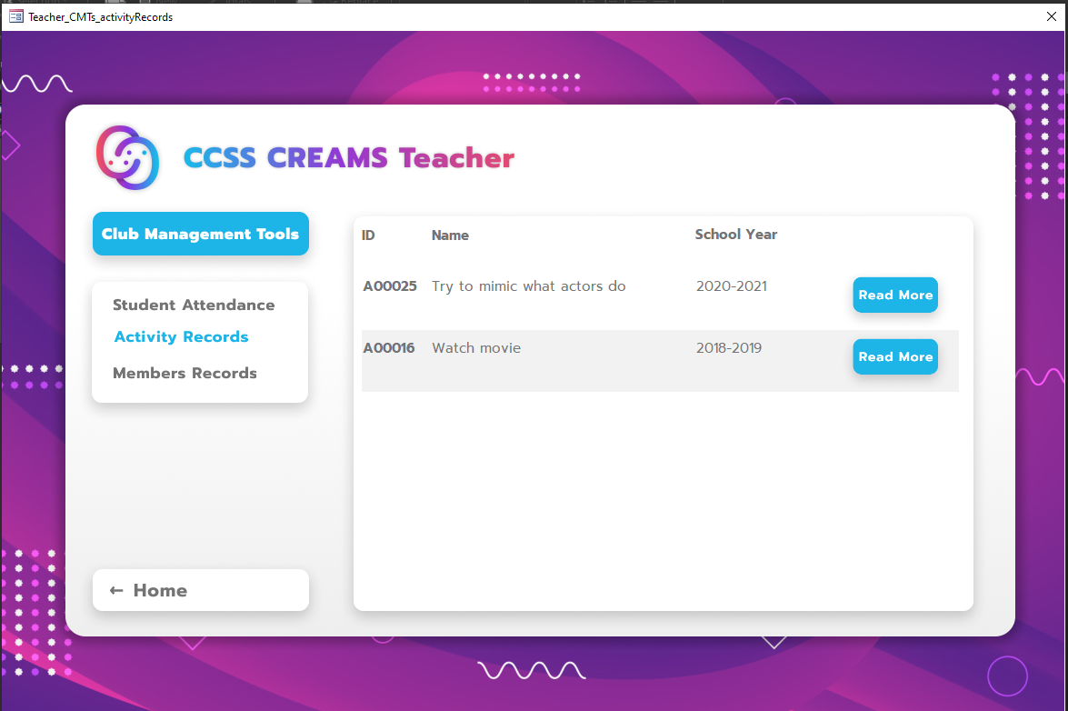
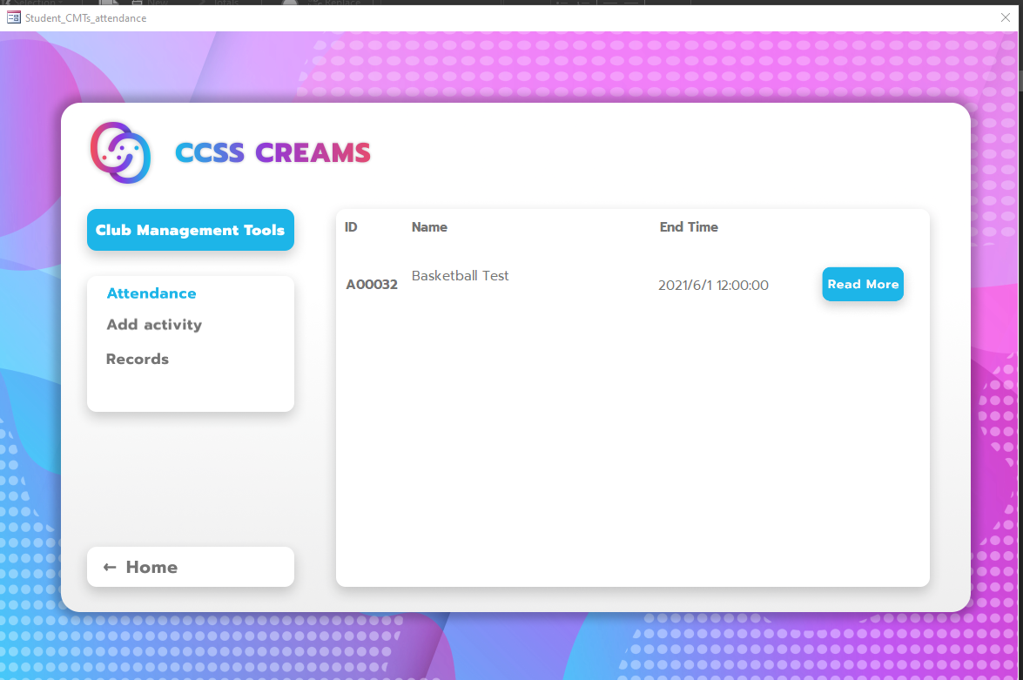
Teacher/ Student CMTs
Attendance
Take attendance for participants
Add Activity
Add activity with information
Activity Records
Show activity records
Home
Back to home page
Member Records (Teacher only)
Show members of the club

Slide 19
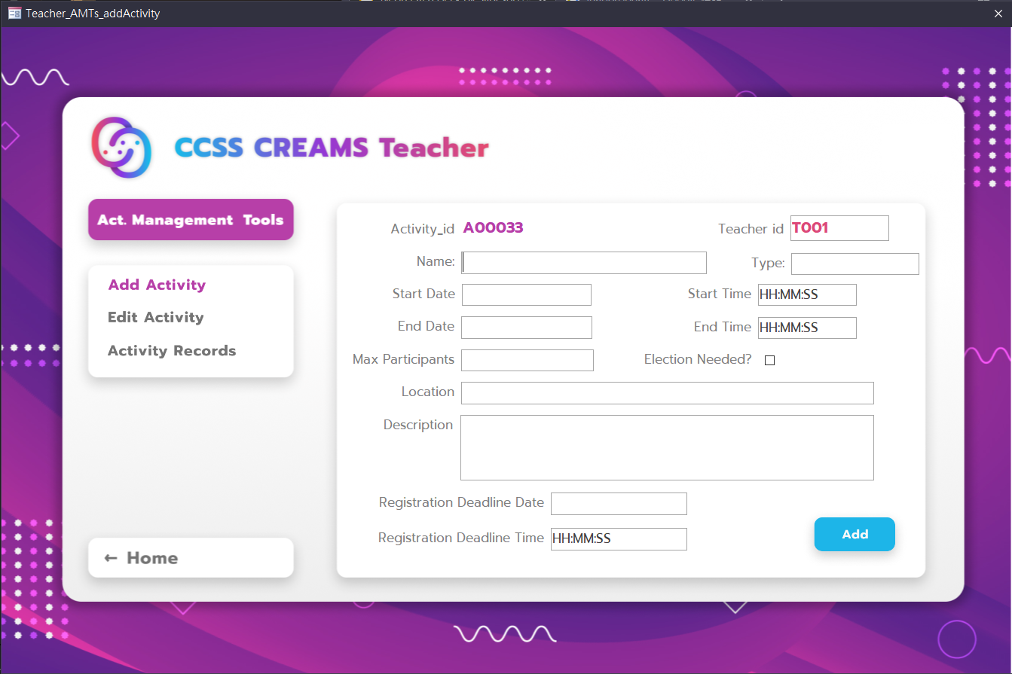
Teacher AMTs
Add Activity
Add activity with information
Edit Activity
Edit activities
Activity Records
Show activity records
Home
Back to home page

Slide 20
Demonstration
(We will show it in live presentation)

Slide 21
Conclusion
Future Improvement:
Payment system
Room booking system

